Slide 1
Remembrance Day Ceremony
Tamworth E.S
November 11, 2021

Slide 2
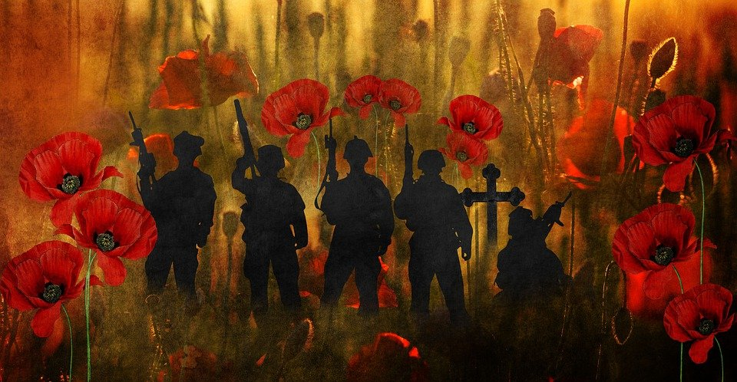
Welcome Message
Land Acknowledgement
Mr. Taylor - Opening remarks

Slide 3
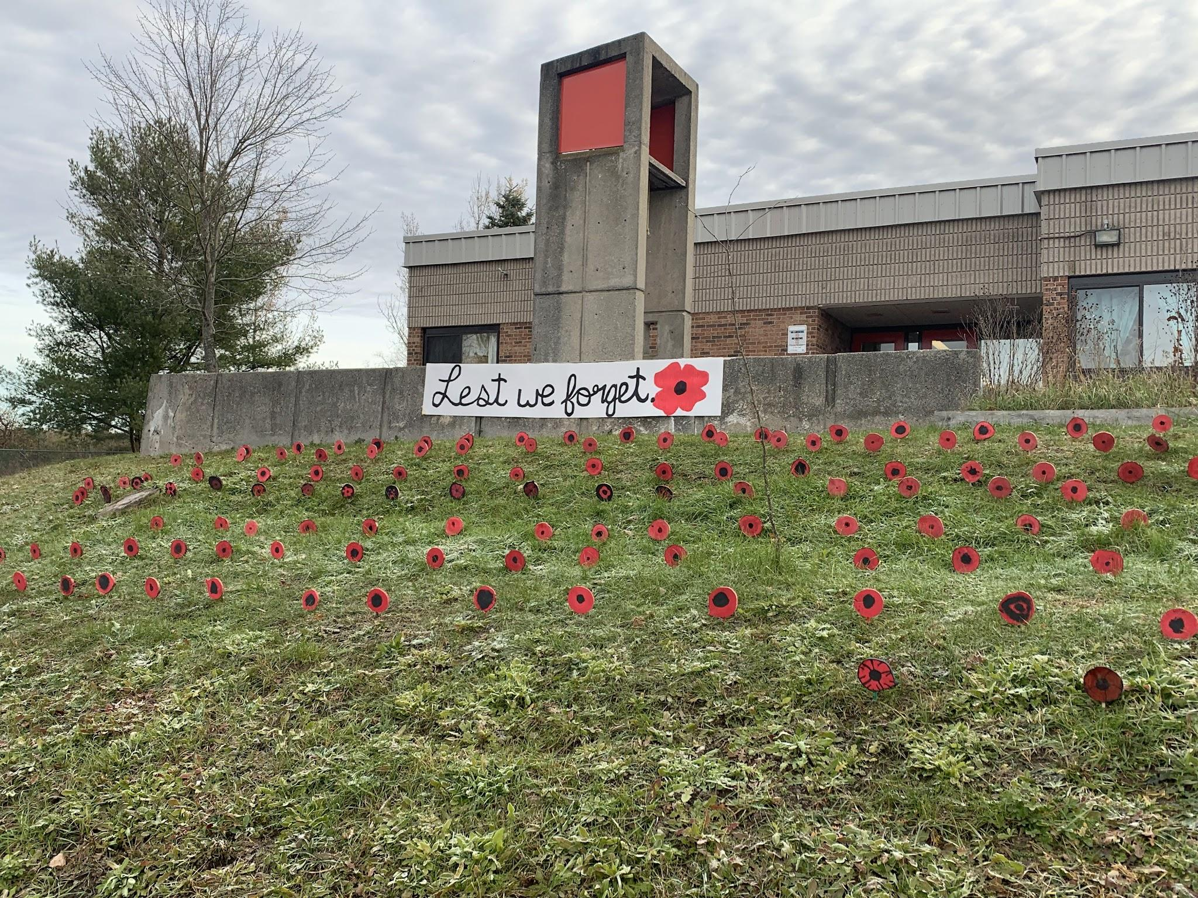
Remembrance Day Ceremony
Tamworth E.S
November 11, 2021

Slide 4
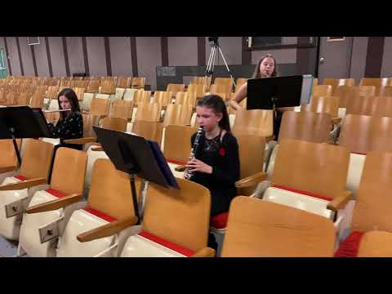
O Canada

Slide 5
In Flanders Fields

Slide 6
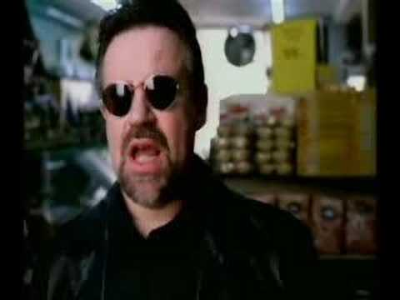

Slide 7
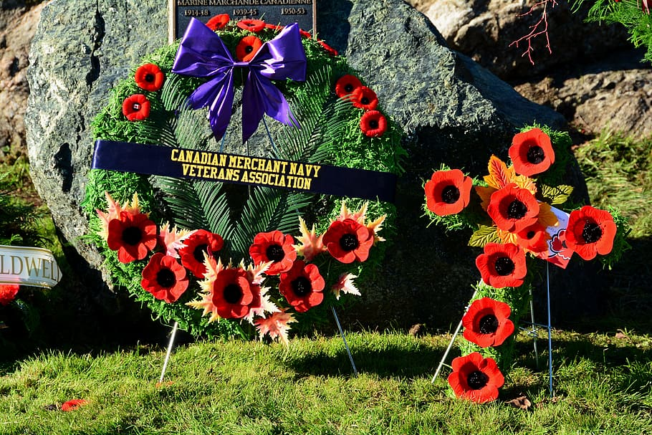
Canadian Armed Forces Speakers
K - GRADE 2
GRADES 7 - 8
GRADES 3 - 6

Slide 8
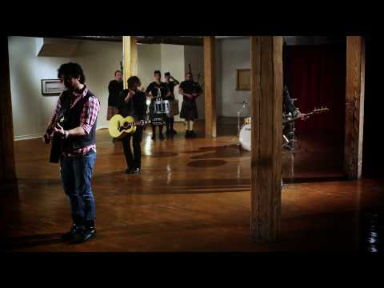
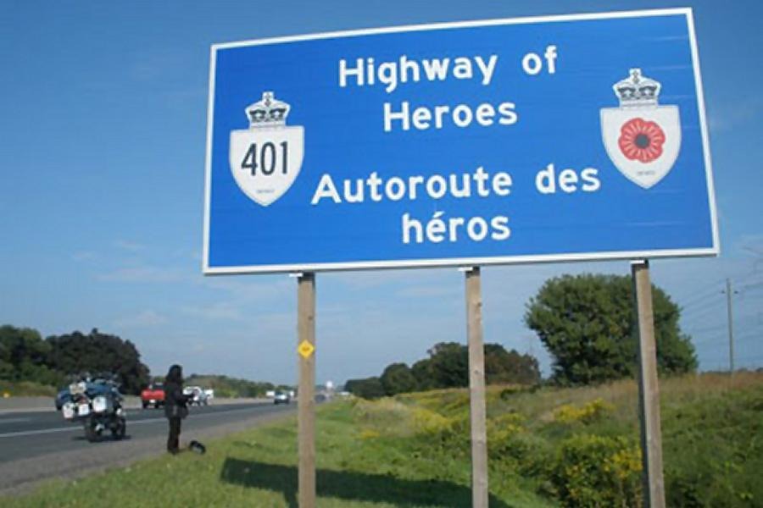
Highway of Heroes
The Trews

Slide 9
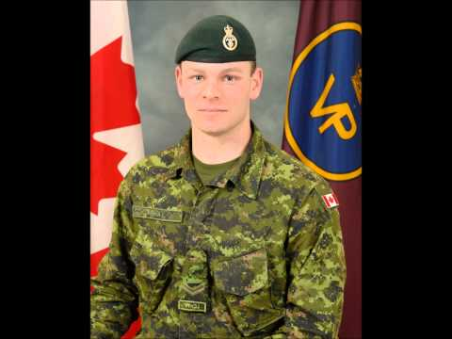

Slide 10
Faces of Freedom Website
Link to the website
Faces of Freedom
Thank you very much for your serious attention to our program this morning.
Explore stories of fellow Canadians, some of whom bravely defended our freedom.

Slide 11
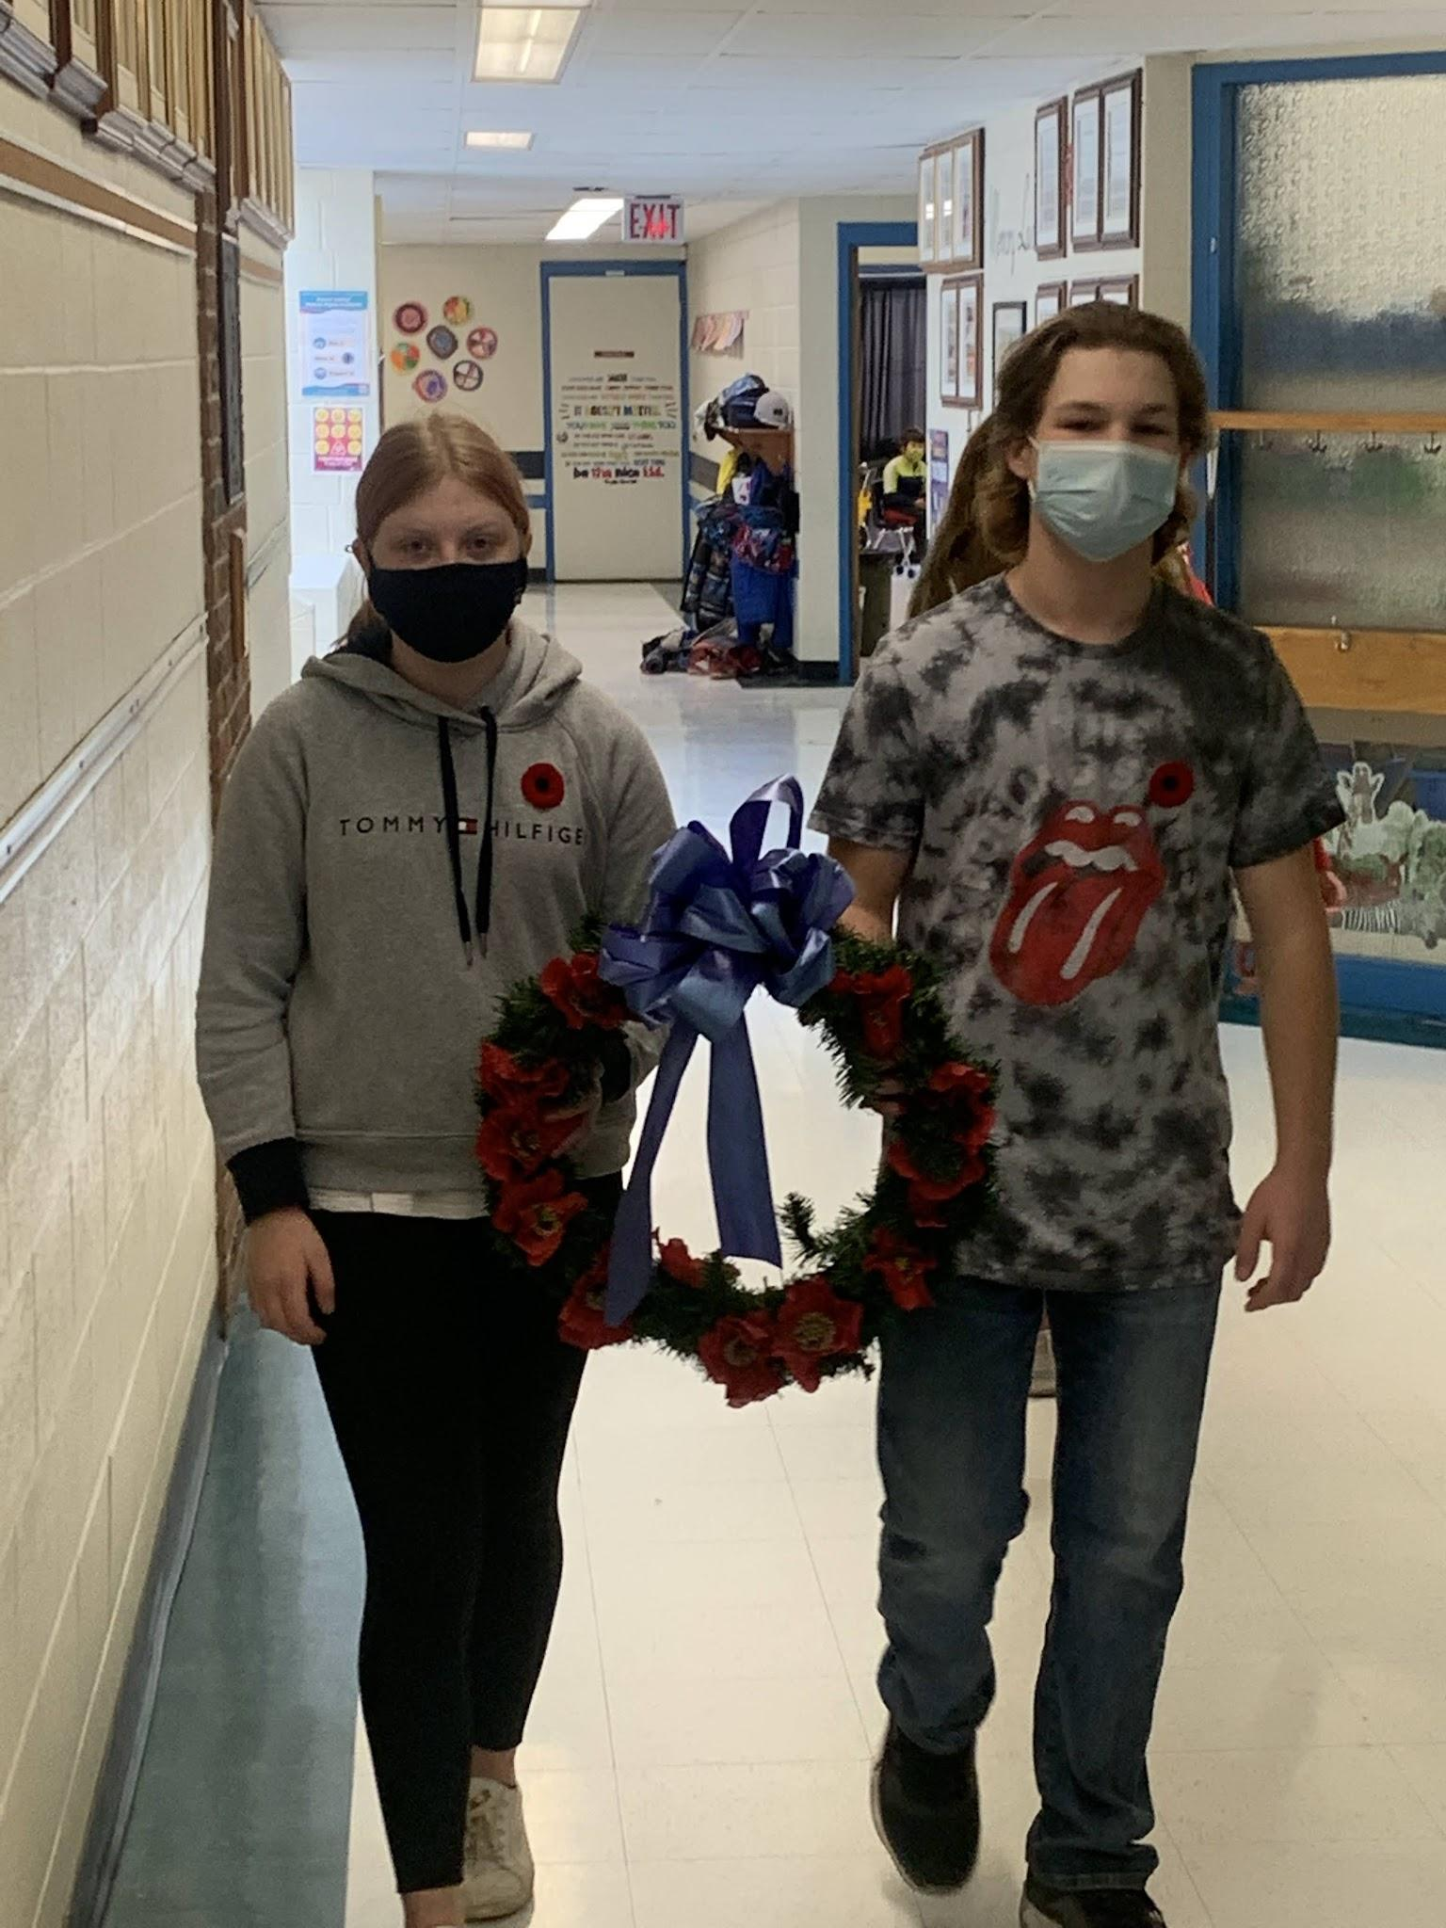
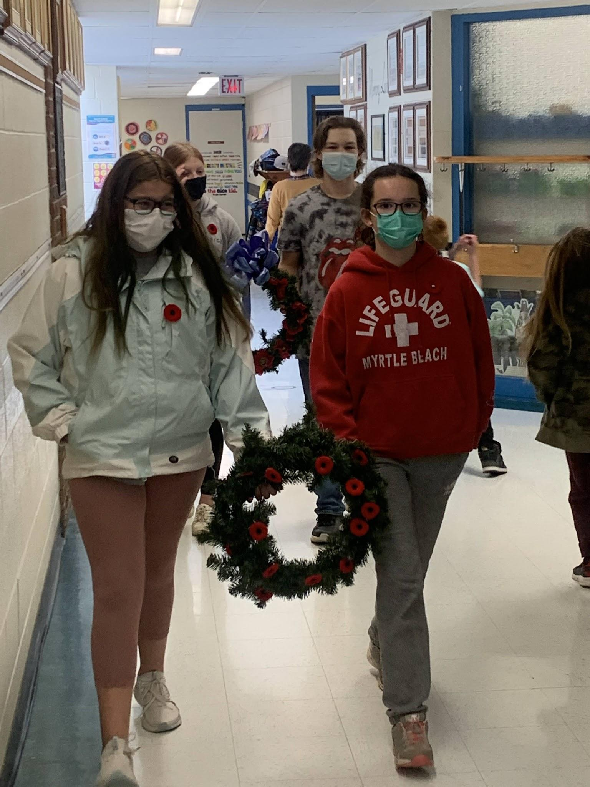
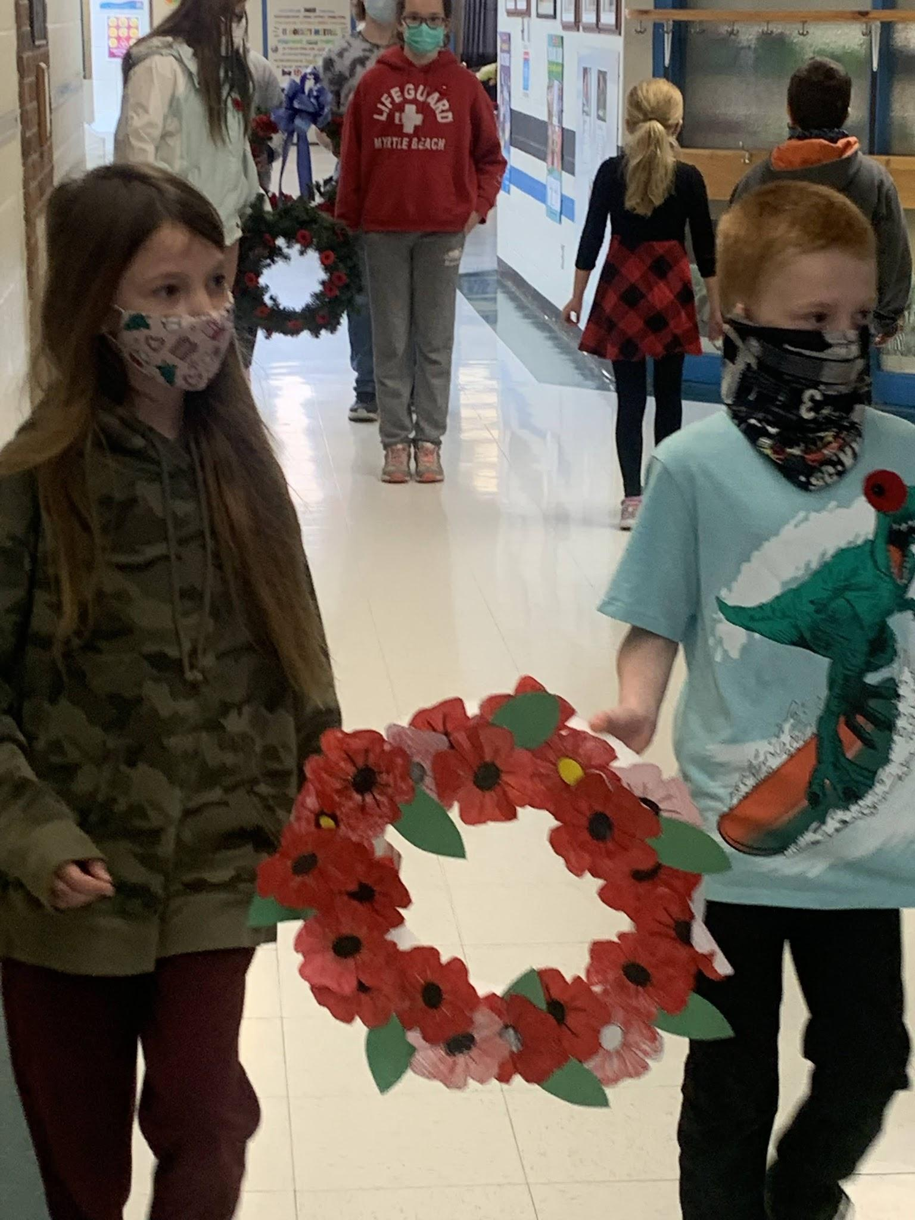
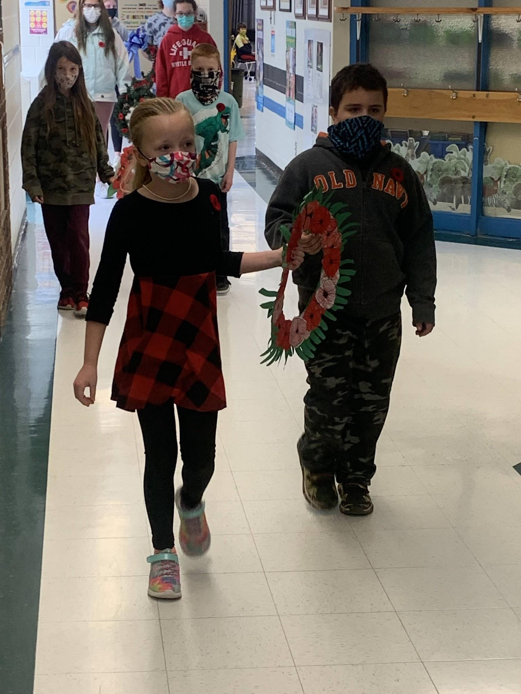
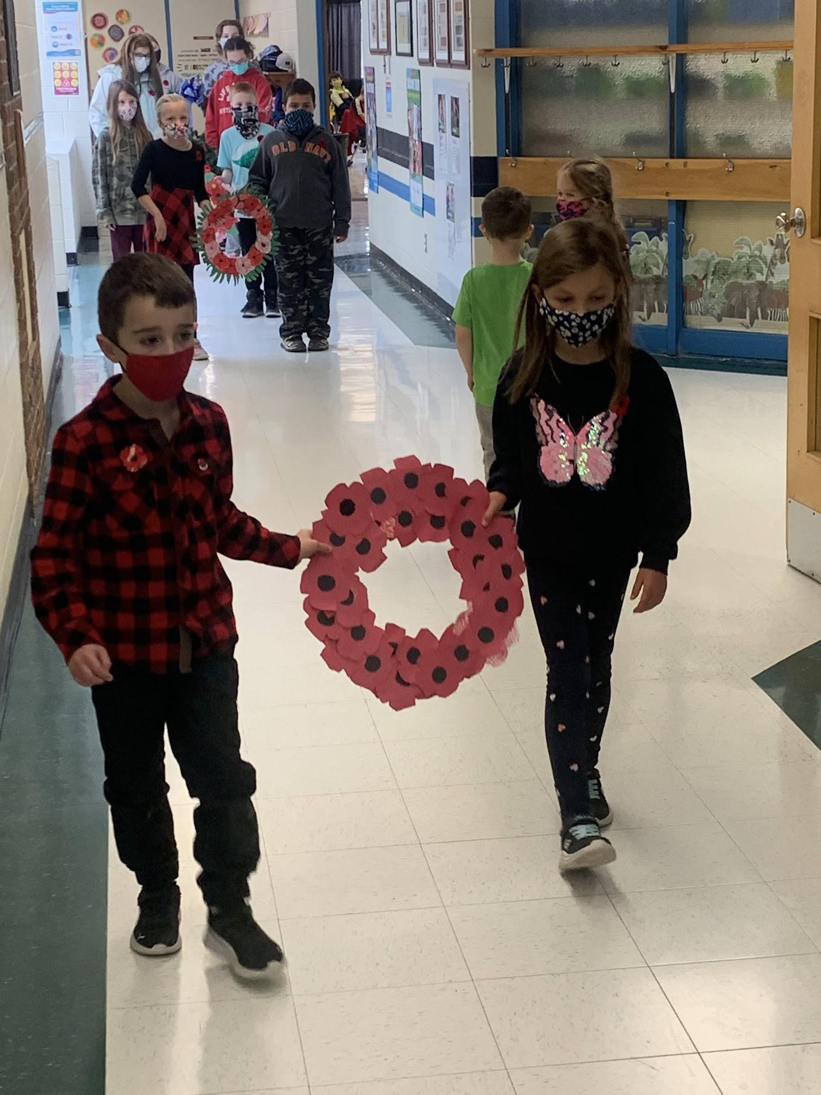
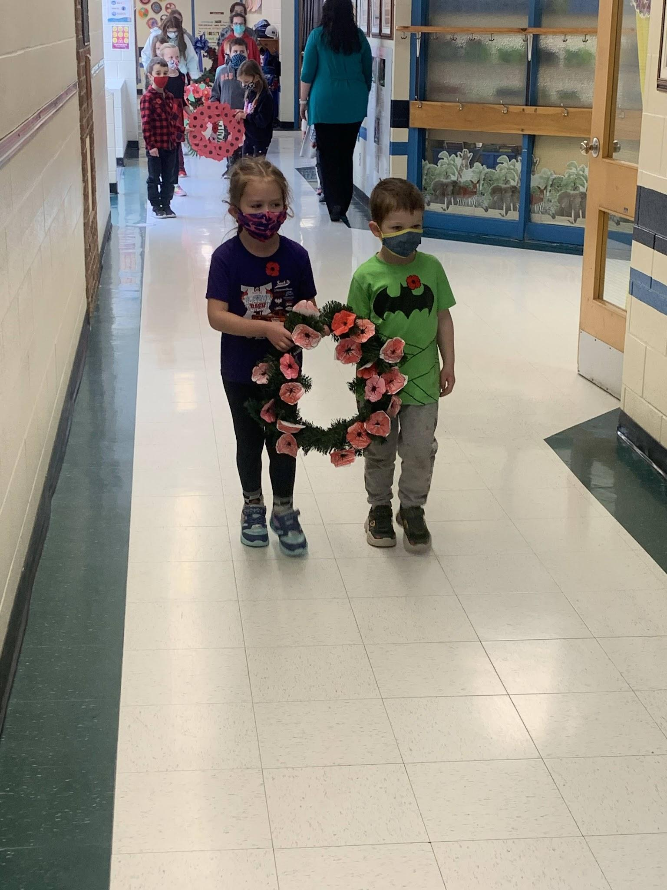
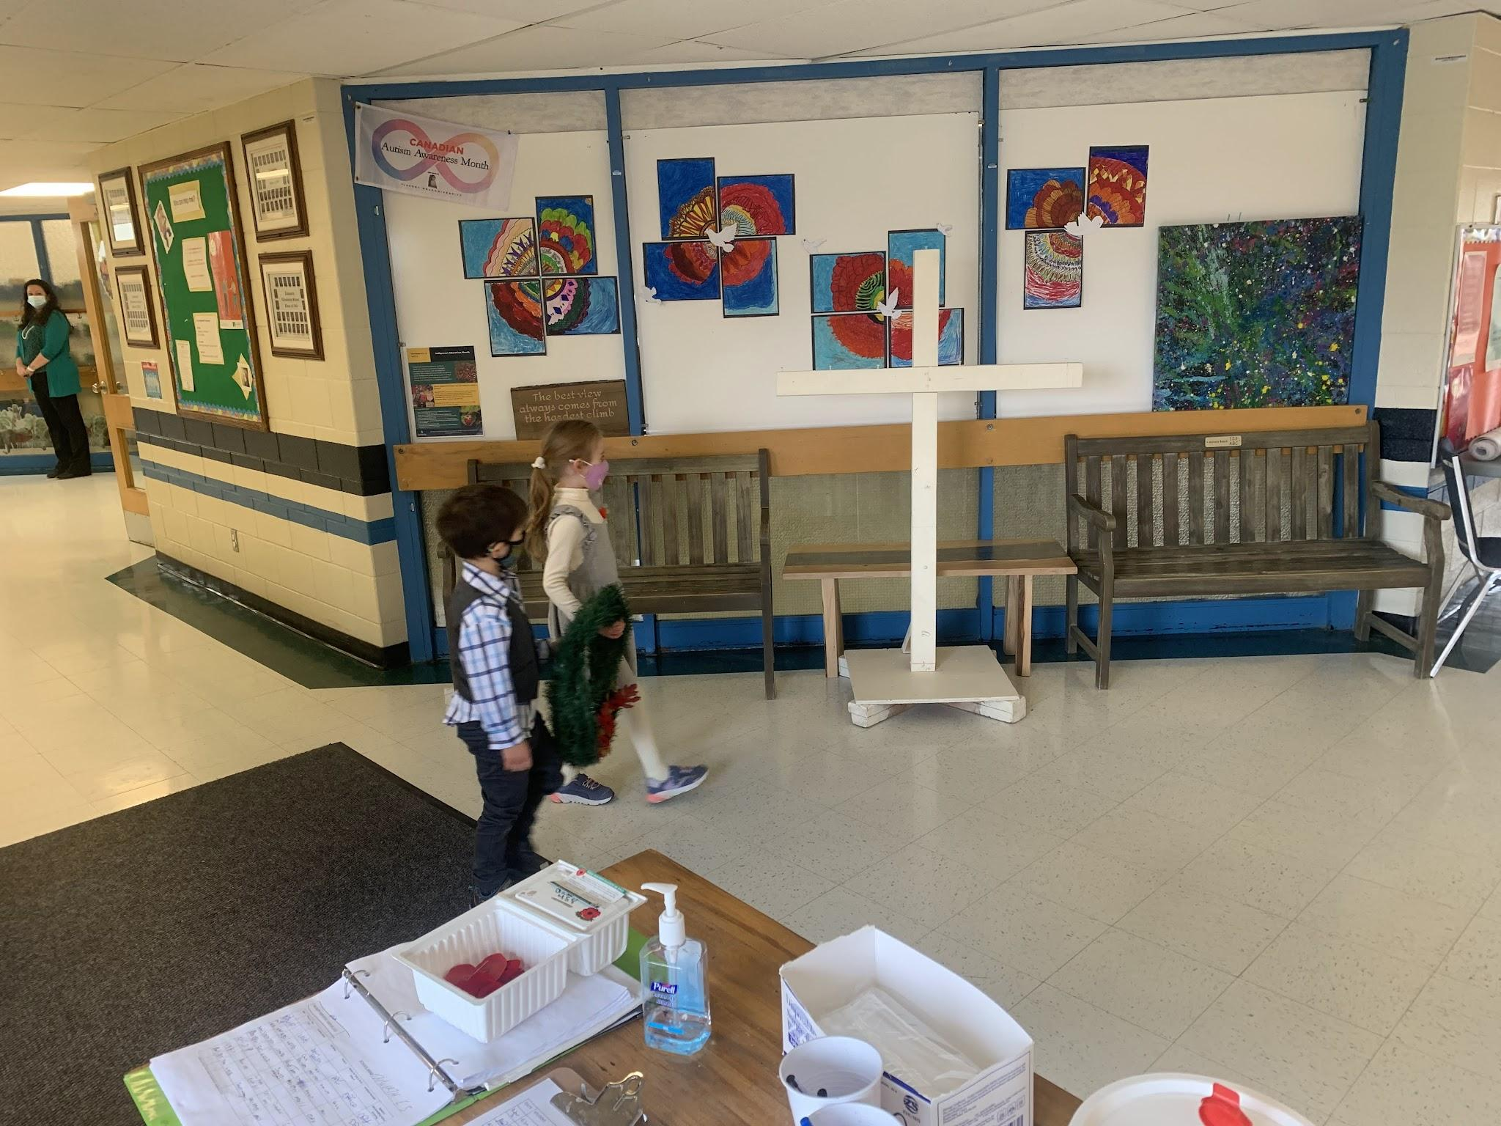
Wreath Laying
We will now honour those who died for us with a wreath laying ceremony.

Slide 12
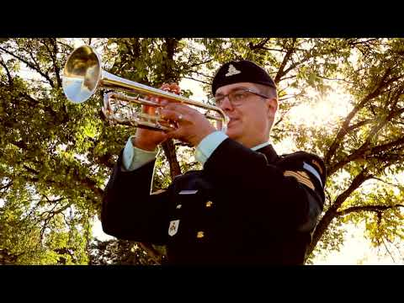
The Last Post

Slide 14
